Slide 1
Automation: live ETL with R

Slide 2
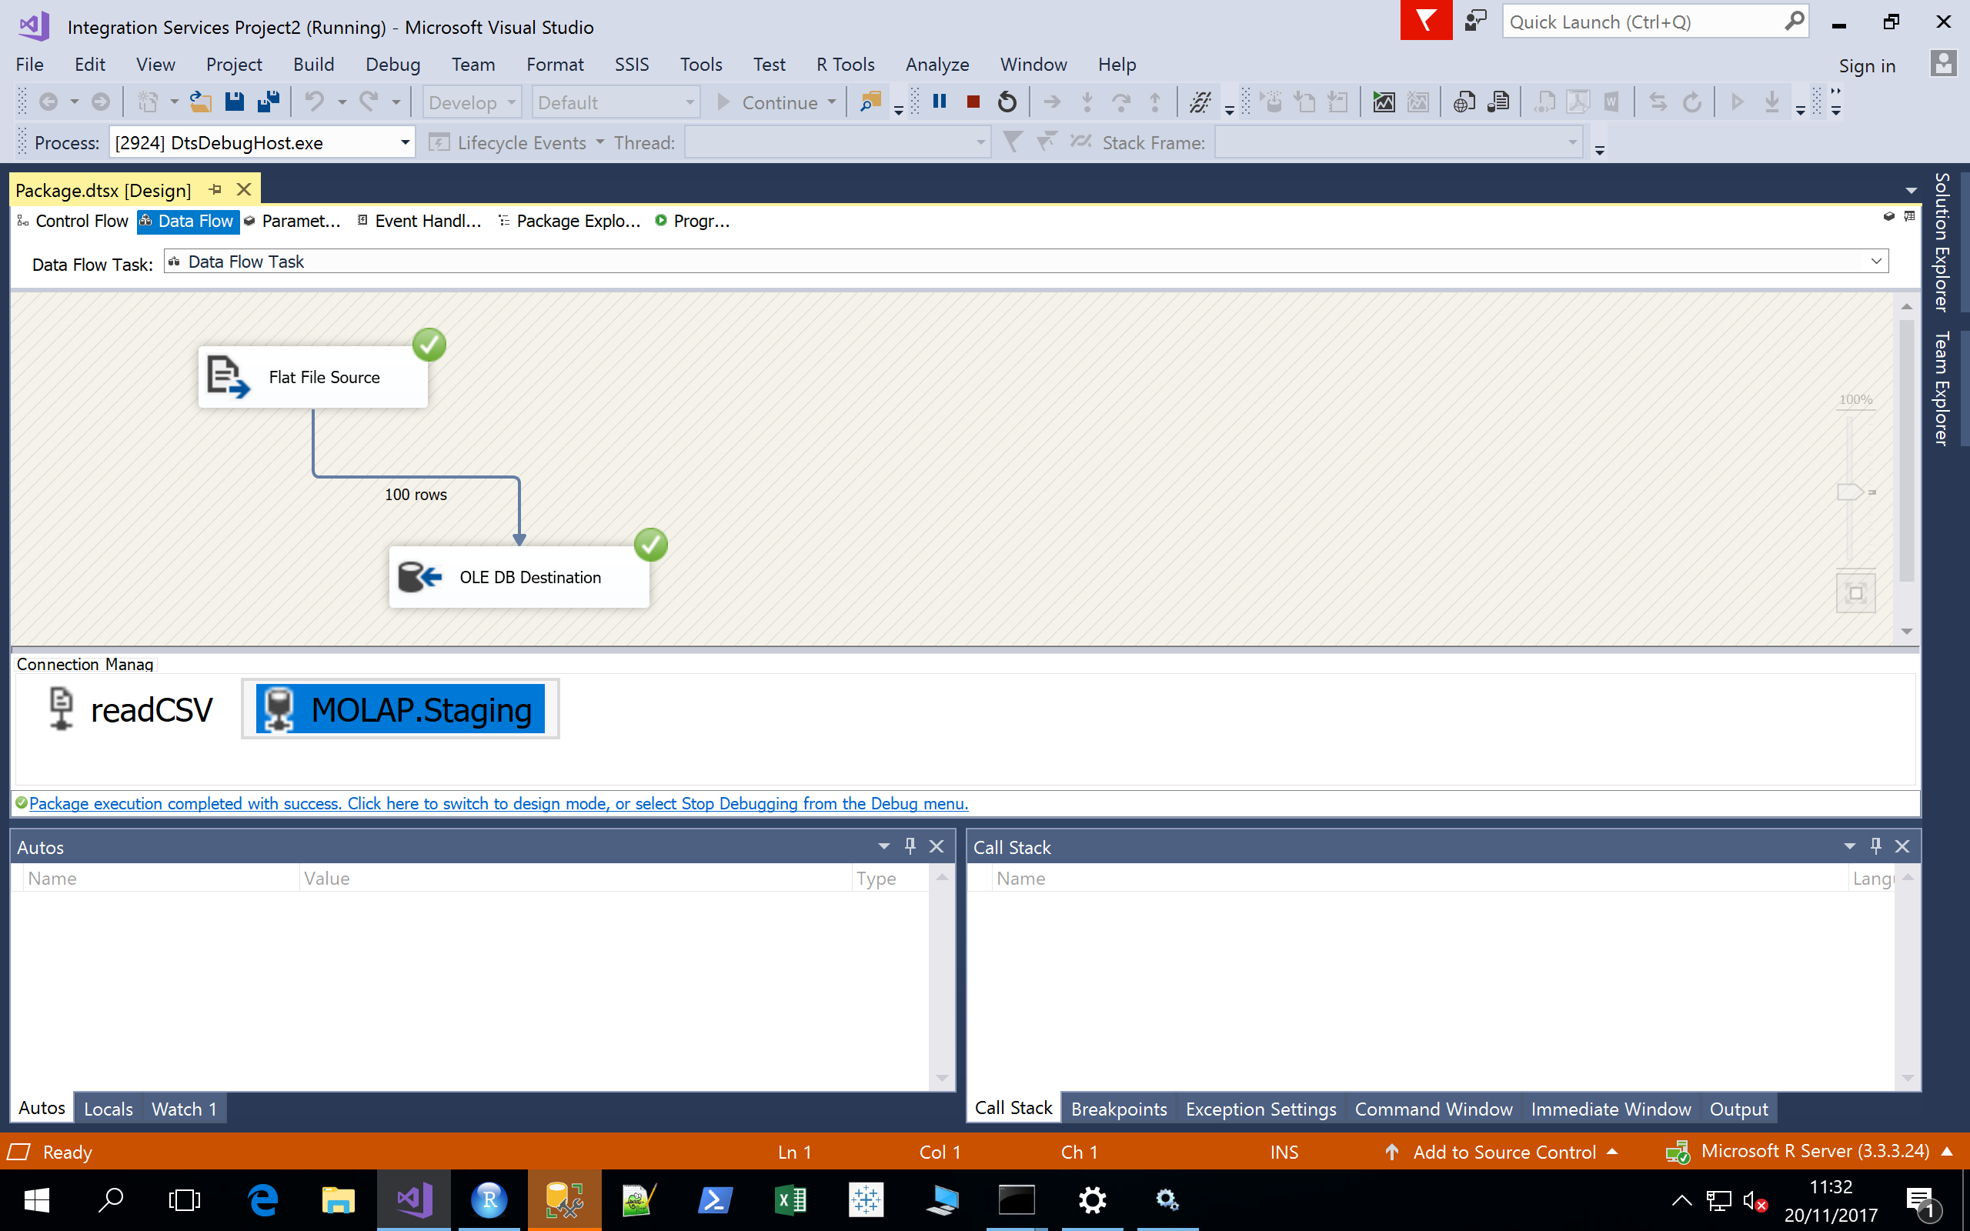
Objectives
Run a helloworld-style R script to demonstrate data generation
Call our helloworld-style R script from SSIS
Ingest the data into a SQLServer staging database
Wash and repeat with R Labs 4 and 5

Slide 3
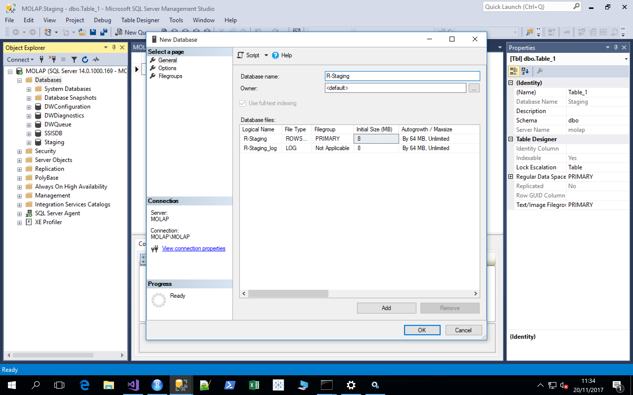
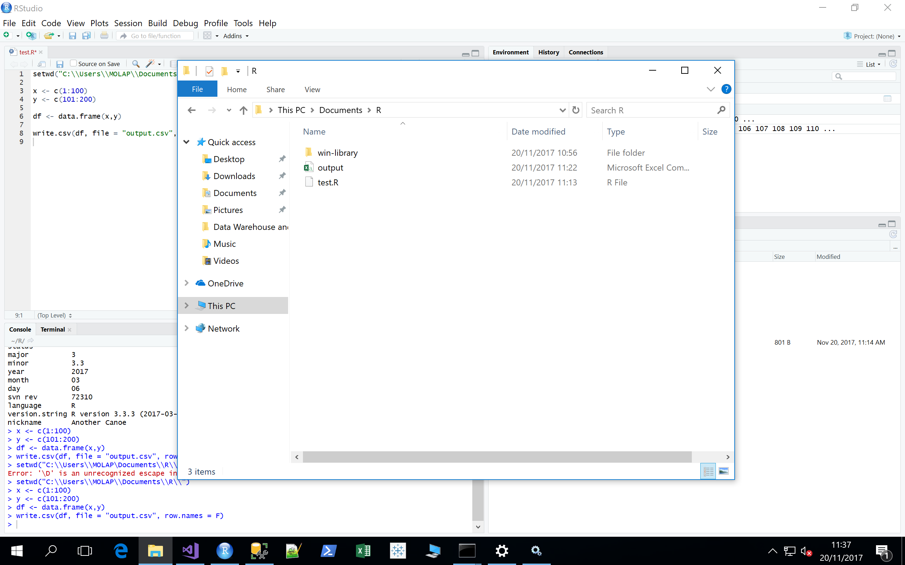
Toy Example: Prepare the Staging, and R Script
Make a new database in SSMS called R-Staging
All the R script does it make 2 columns, each with 100 numbers, and output the resultant data.frame to the hard disk.
2. Make a new Rscript called test.R
setwd("C:\\Users\\MOLAP\\Documents\\R\\")
x <- c(1:100)
y <- c(101:200)
df <- data.frame(x,y)write.csv(df, file = "output.csv", row.names = F)
Execute it, and save it here:
It’s important to execute it before moving to SSIS, so that we know the structure.
It produces

Slide 4
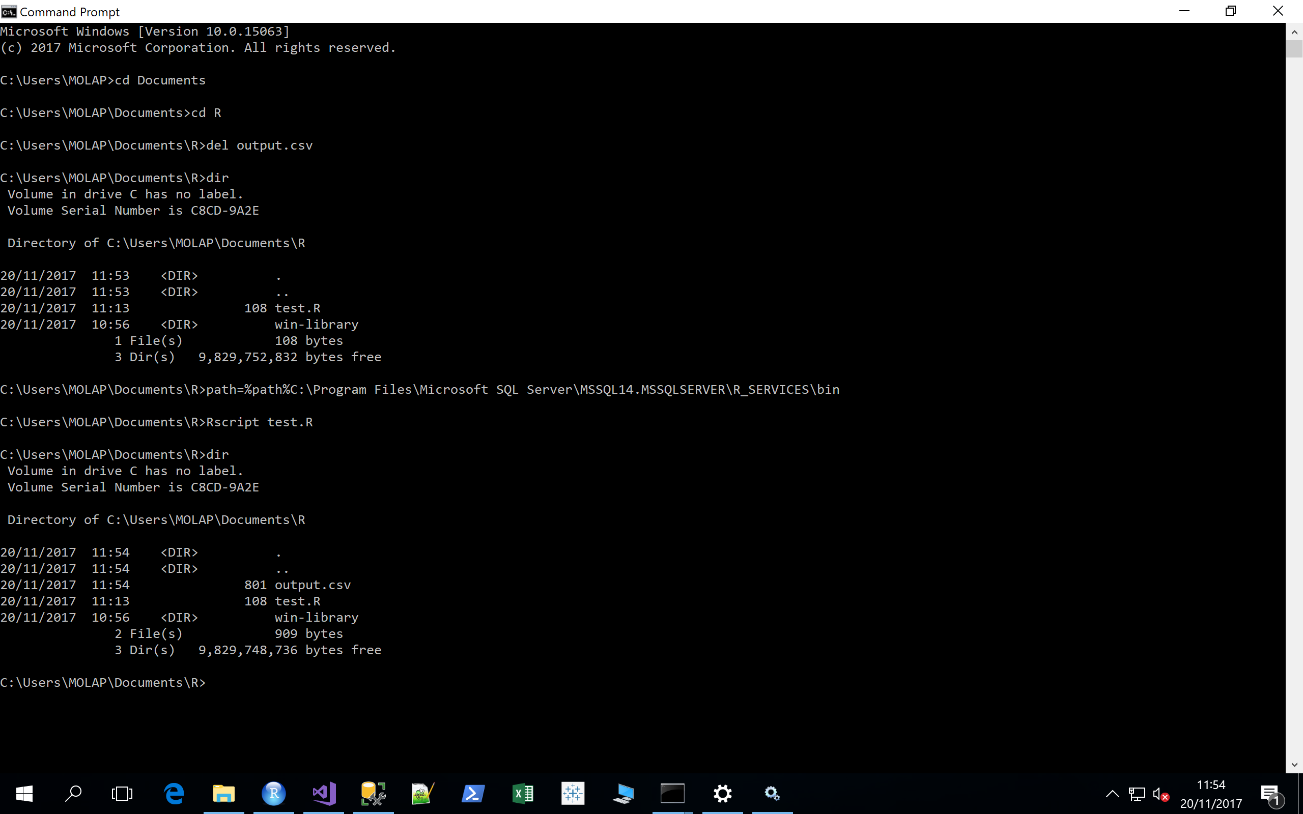
Calling R from the command line is Extremely Useful!!!
Change directories
Delete the output
It’s gone
Add Rscript.exe to the windows search path (so it can be called from the command line)
Run our function
It’s back! ☺

Slide 5
Toy Example: Running R from SSIS and Capturing the results with Rscript
Now we’re going to do essentially the same thing, but with SSIS.
Whilst this example is extremely simple, it opens up the ability to do anything that R can do, but within a reproducible ETL process.
Thus, it will make things a lot easier with respect to:
Modelling
Transformation
Extraction, and
Cleaning
Refresh loading
of data.

Slide 6
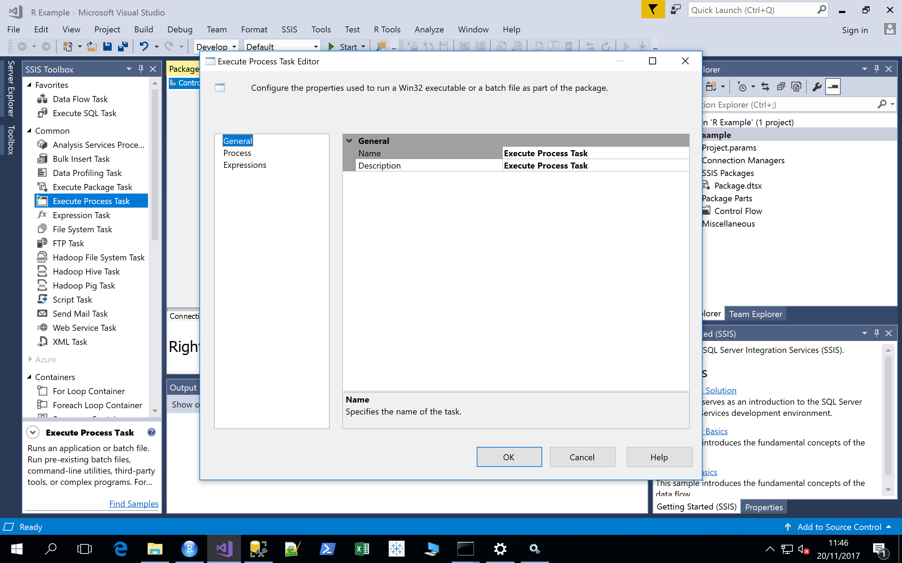
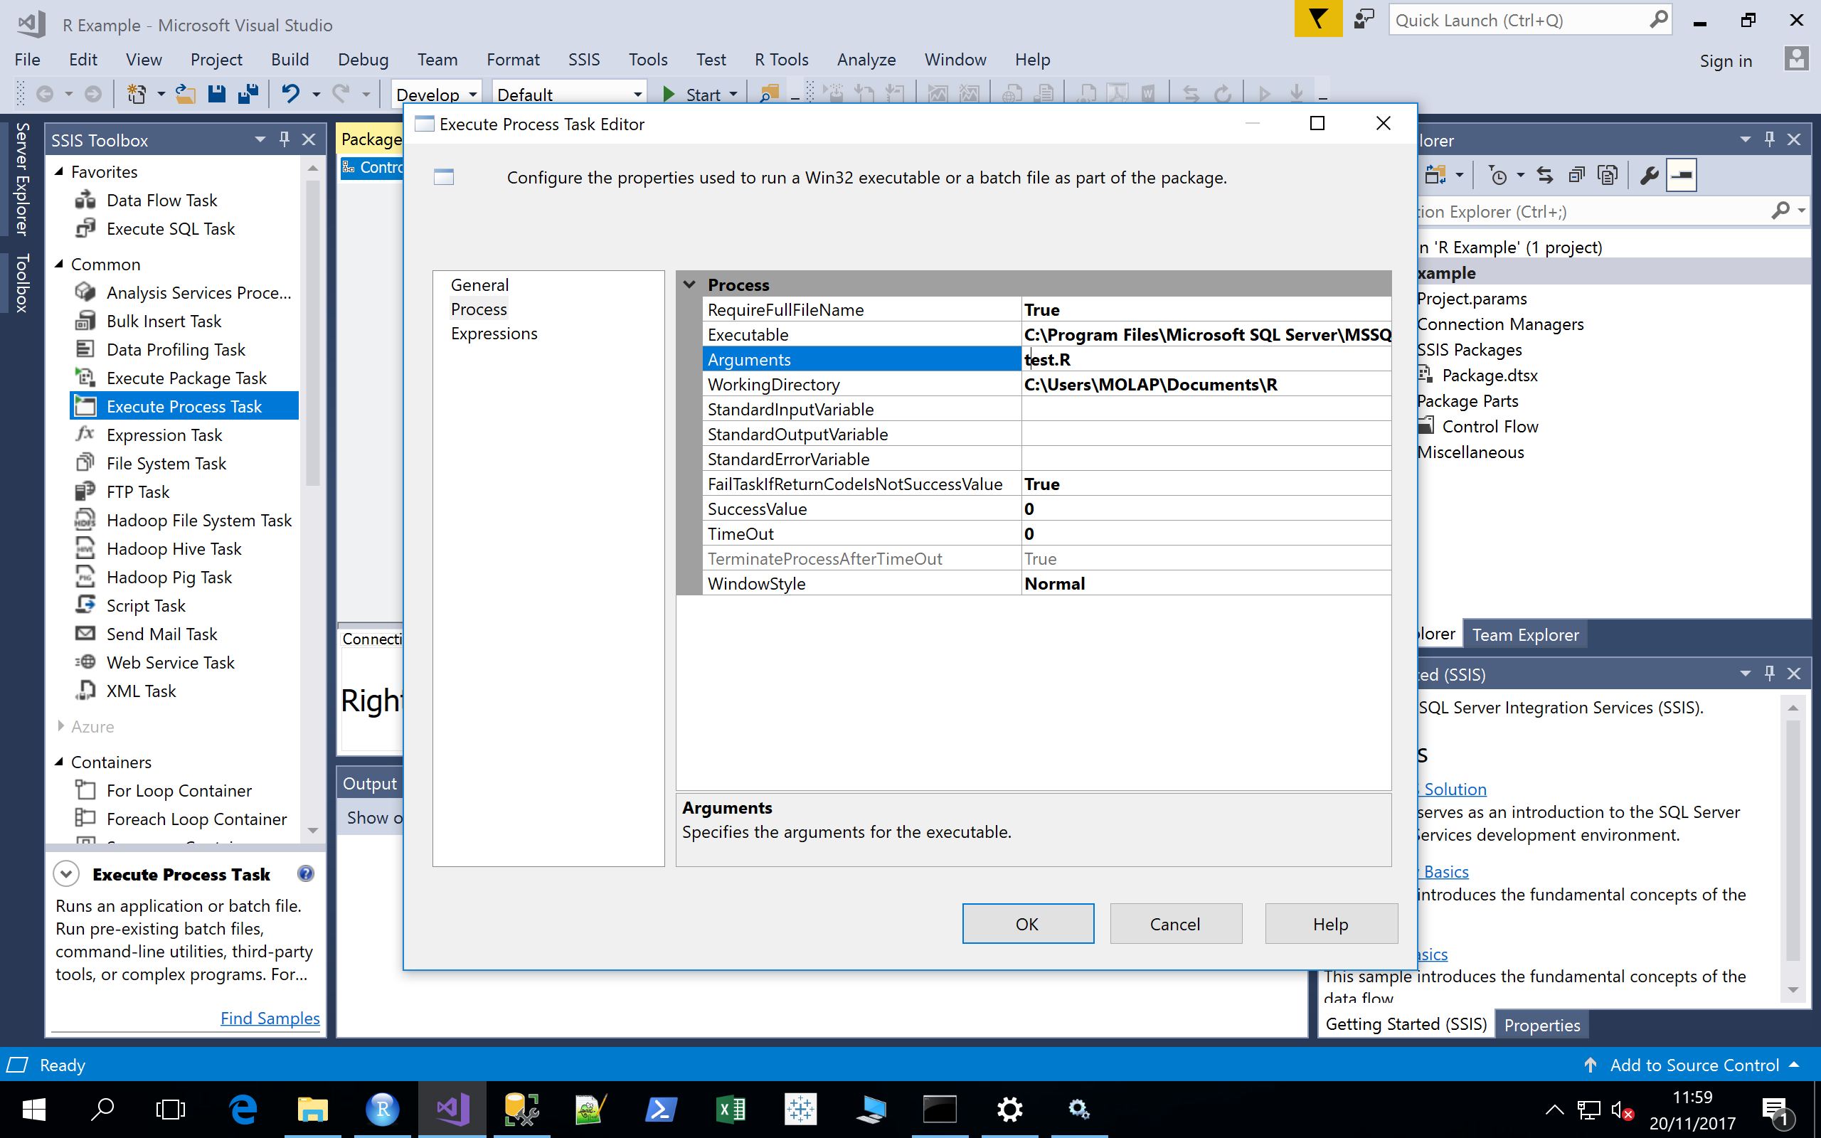
Toy Example: Running R from SSIS and Capturing the results with Rscript
Make a new Integration Services project.
Add Execute Process Task into the package
Insert the following:
Executable: C:\Program Files\Microsoft SQL Server\MSSQL14.MSSQLSERVER\R_SERVICES\bin\Rscript.exe
Arguments: test.R
Working Directory: C:\Users\MOLAP\Documents\R

Slide 7
Toy Example: Running R from SSIS and Capturing the results with Rscript
What did we just do?
Essentially wrapped SSIS around R.
Now provided we are smart in how to hand over data from R to SSIS, anything R can do, SSIS can now also do.
This includes:
Extracting Data from the Web and/or Social Media
Cleaning Data, and
Transforming Data

Slide 8
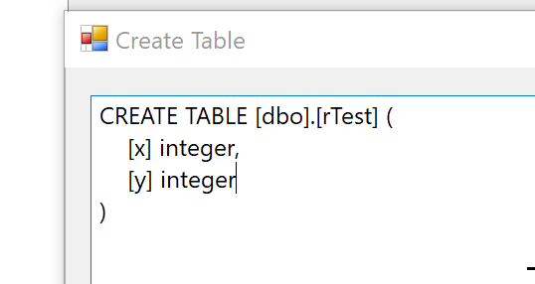
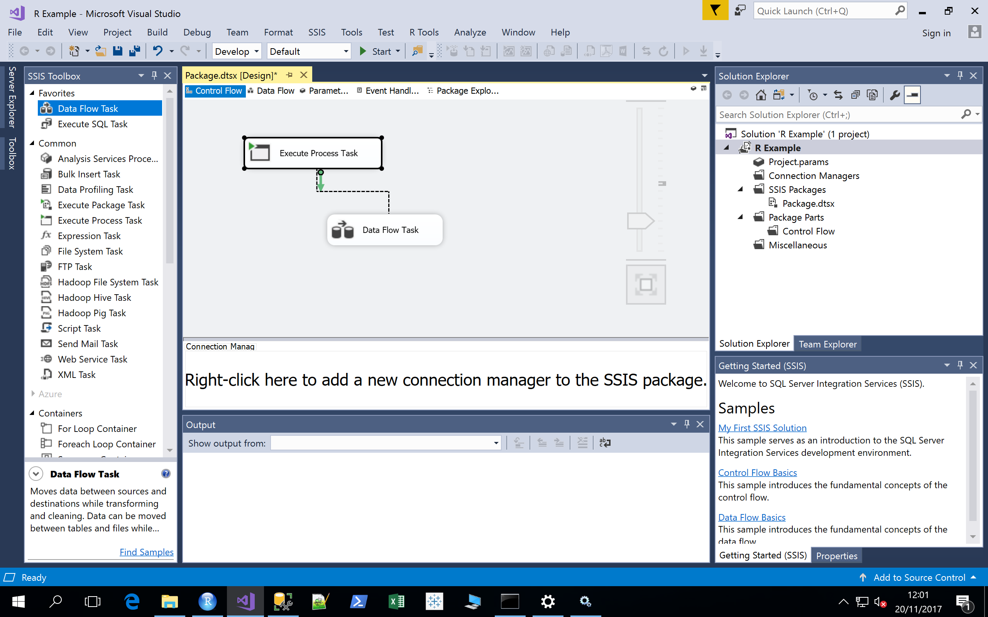
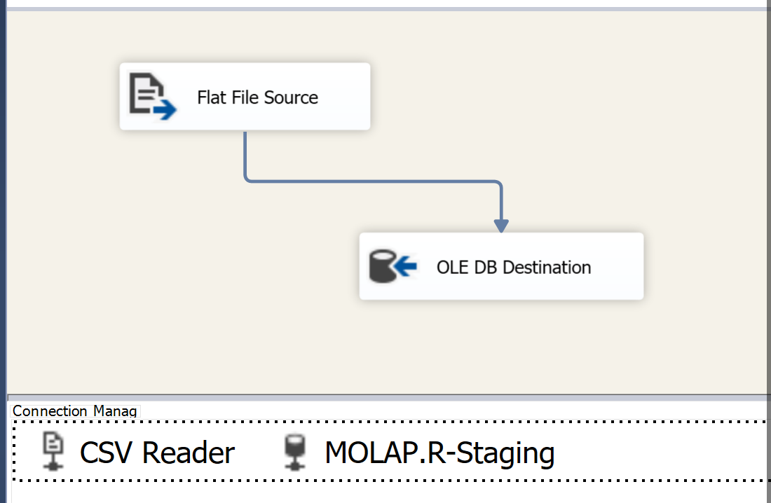
Toy Example: Running R from SSIS and Capturing the results with Rscript
Now make a data flow task, and connect it to the the execute process task
Now we edit treat output.csv as a flat file source.
Make a table, flatfilesource, and OLE DB target and put output.csv into R-Staging

Slide 9
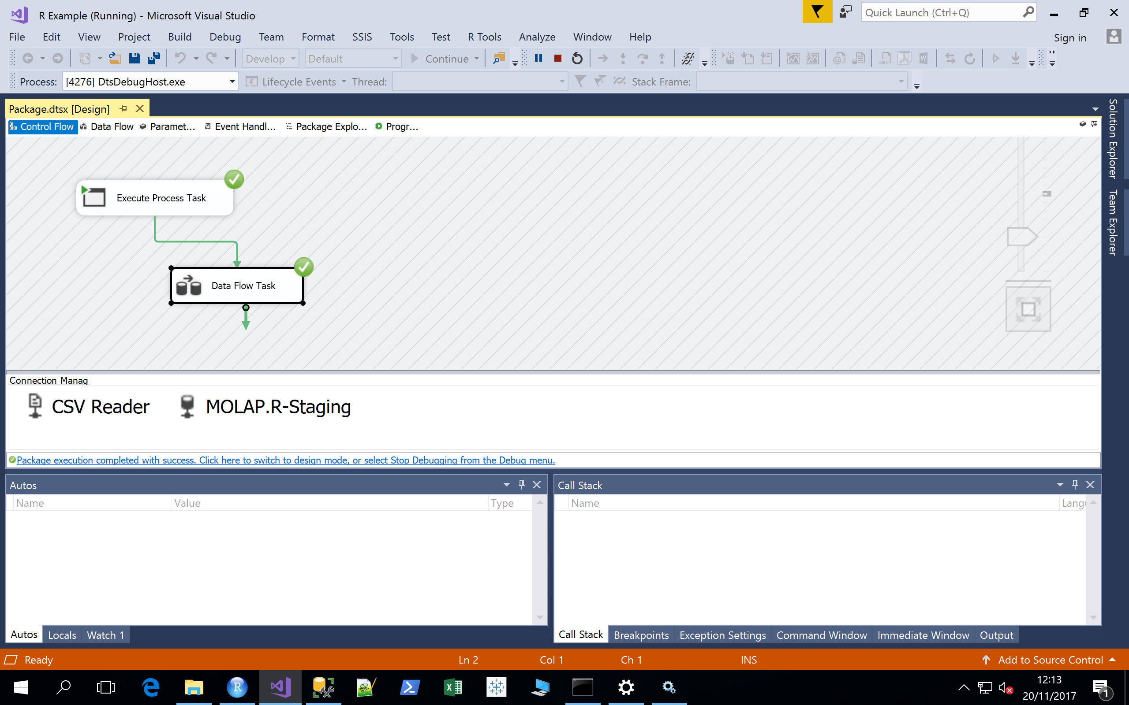
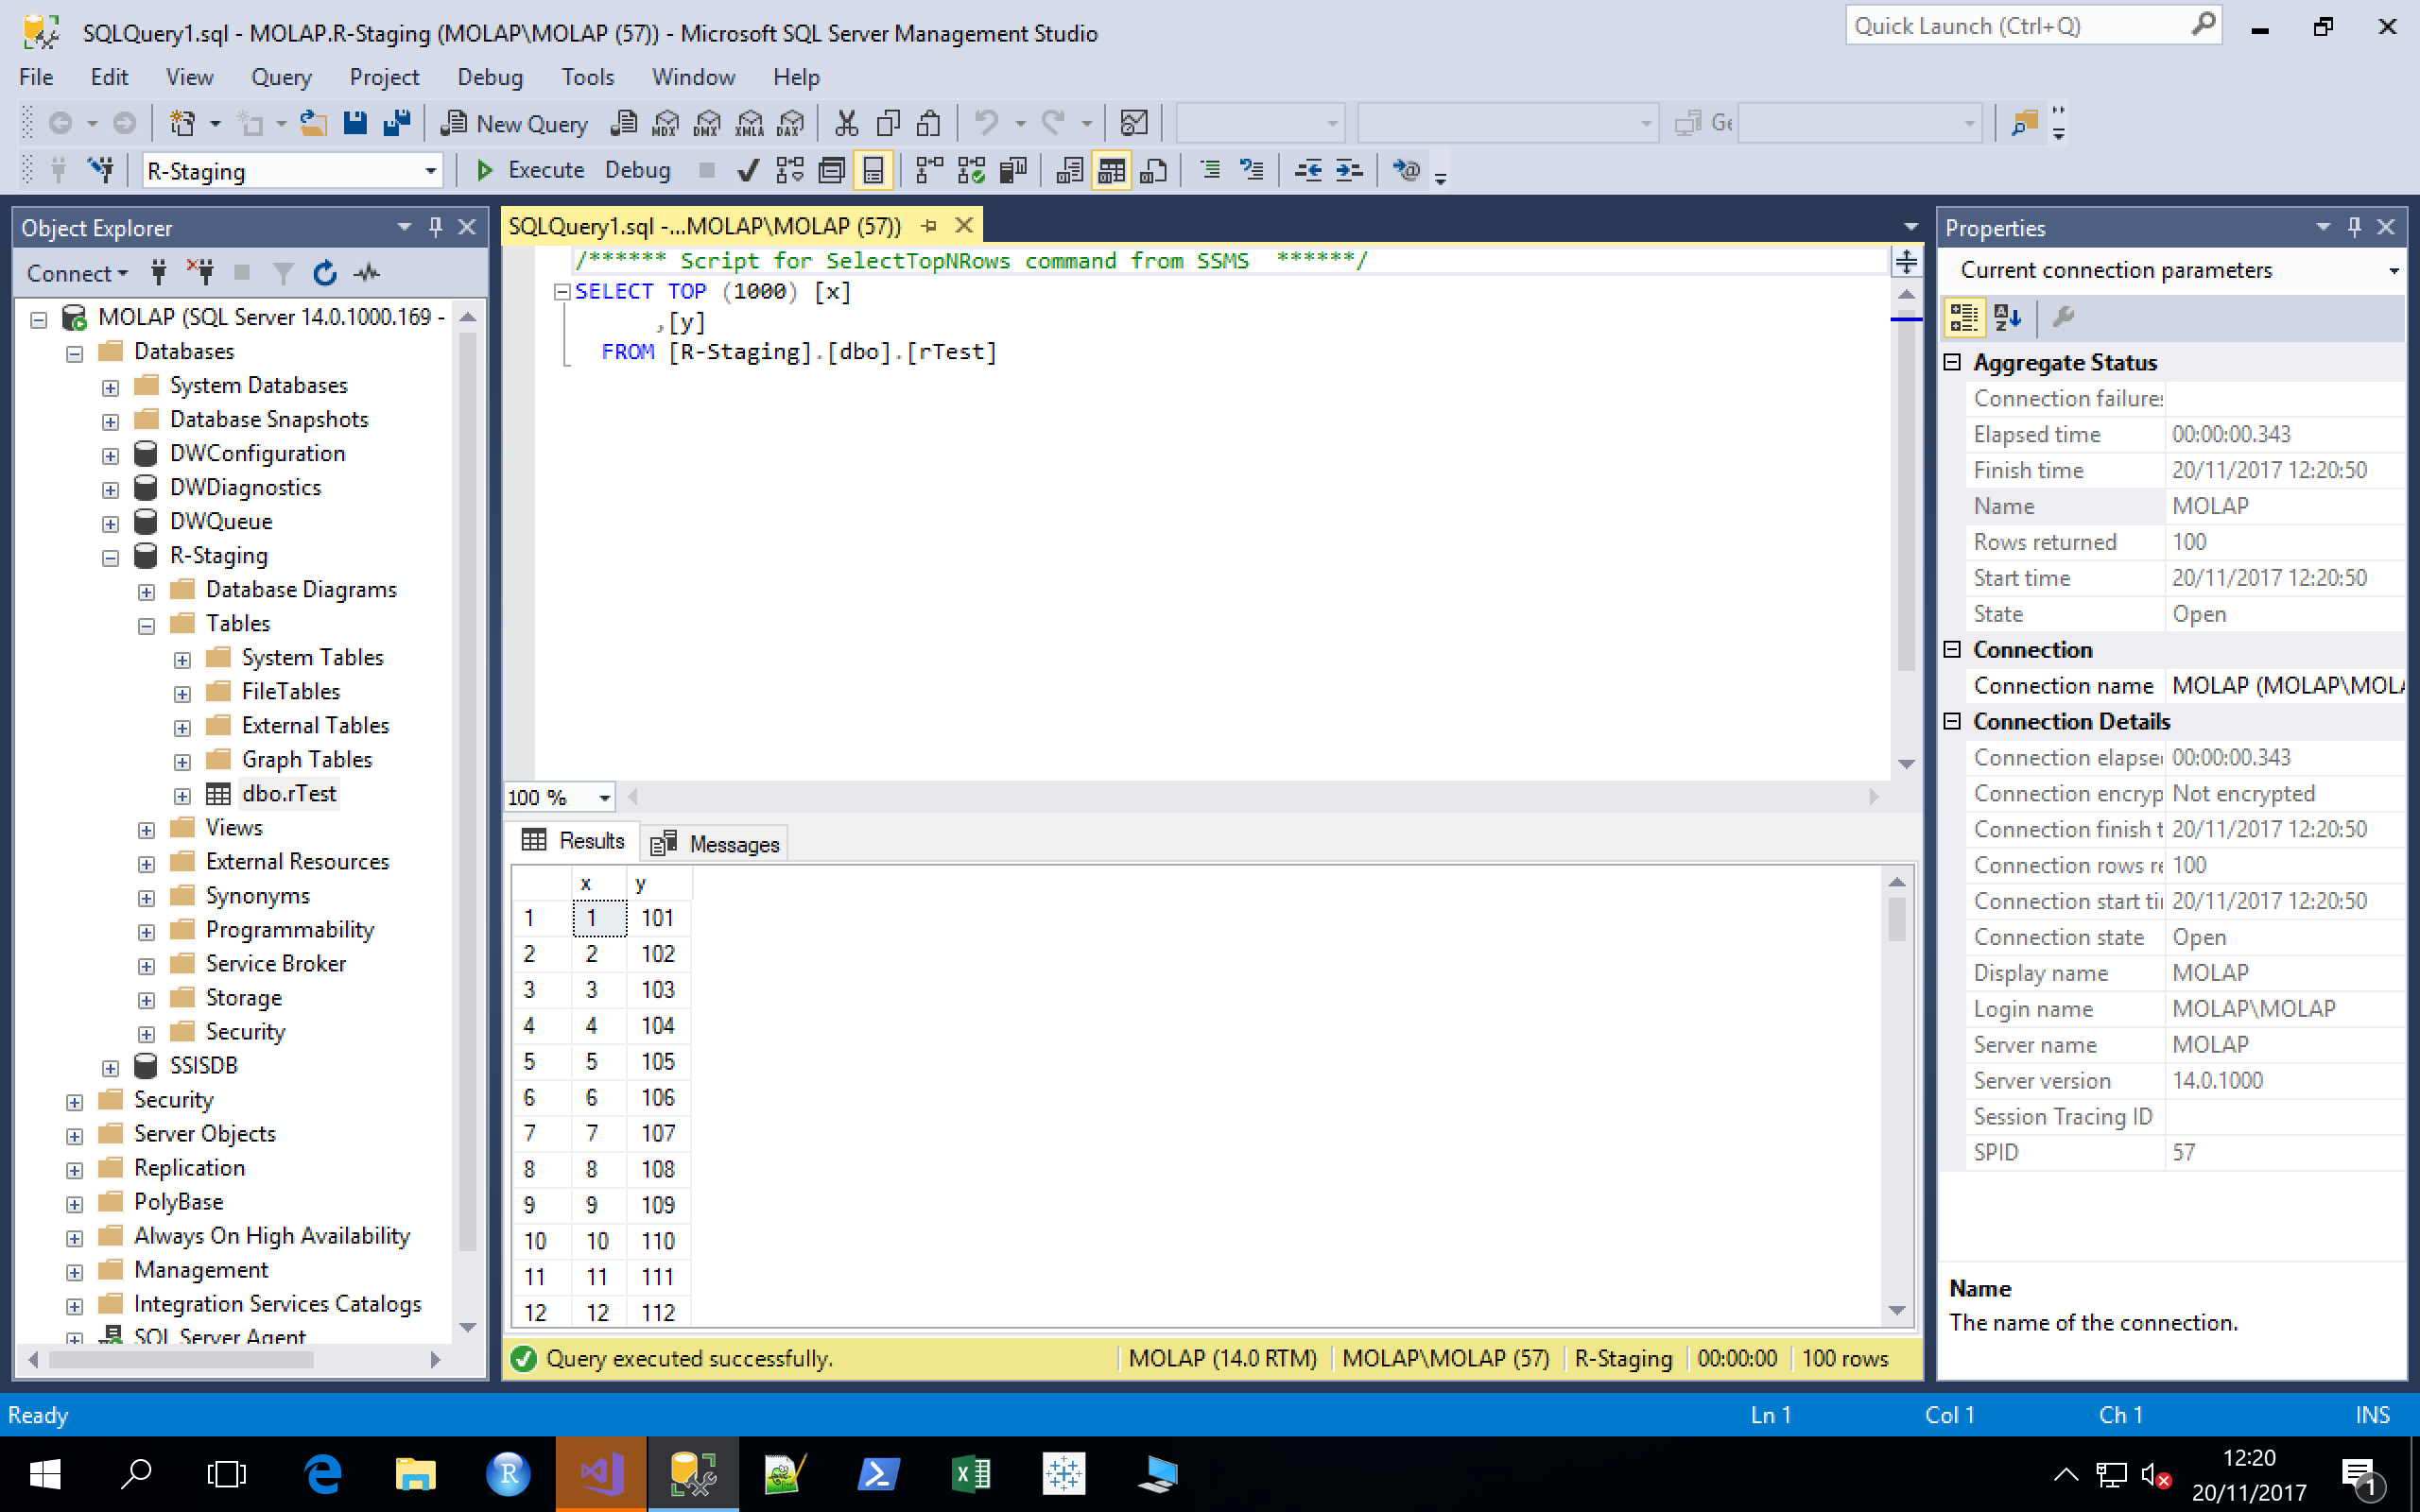
Toy Example: Running R from SSIS and Capturing the results with Rscript
Now run the project

Slide 10
Toy Example: Running R from SSIS and Capturing the results with Rscript
Note: We haven’t handled “new” data or refresh loading here. If you run the package more than once, you will just load the data again, as there are no primary keys in this example. It’s purpose is only to demonstrate how to connect the R labs to the SSMS, SSAS and SSIS labs. By the way, you can follow a very similar process to run Java, Python and other applications that have a command line interface.

Slide 11
Exercises: Rinse and Repeat for any R code you have
We’ve just seen a simple example. Now, fix up your solutions to lab 4 or the Twitter lab, and do the following:
Structure your R code, so that it produces structured output (a .csv) that matches what you want in your staging areana
Wrap it as per the toy example, and combine SSIS staging and data prep with R cleaning and transformation
Add in quality control measures (e.g. no repeated data) within your ETL process and automate your entire ETL process

